Slide 1
Linear Algebra
线性代数
Zongbin Chen YMSC, Tsinghua University
陈宗彬 清华大学数学科学中心
Email: zbchen@tsinghua.edu.can

Slide 2



Quick review
System of linear equations, also called a linear system （线性方程组）
Matrix form (矩阵形式）

Slide 3
Augmented matrix（增广矩阵）

Slide 4
Vector spaces, as generalization of Euclidean geometry（欧式几何）

Slide 5
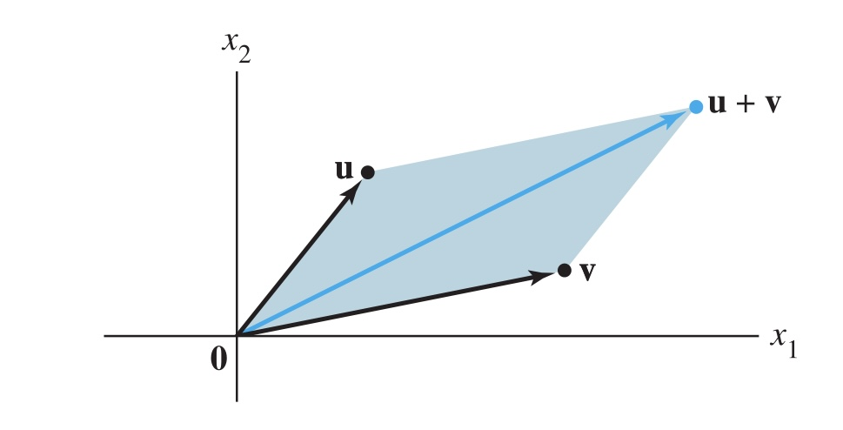
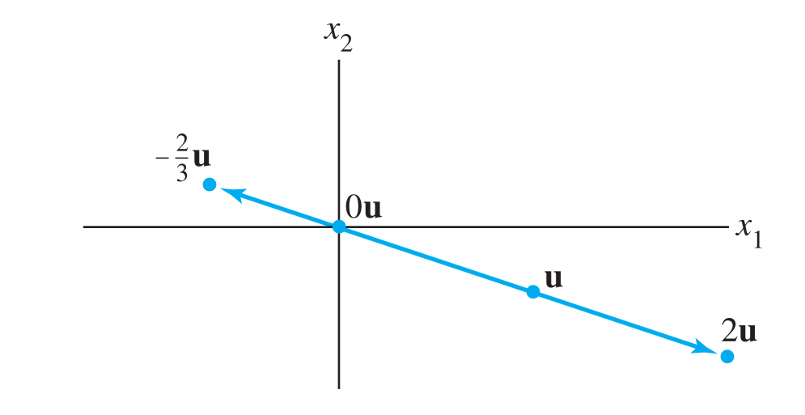
Addition of vectors is described by the rule of parallelogram
Scalar multiplication

Slide 6
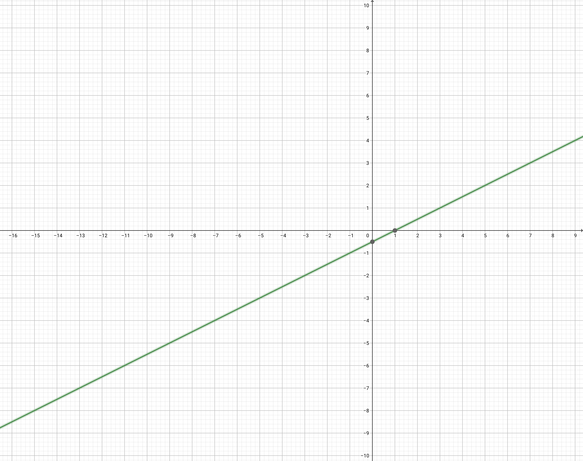

The vector calculus in $R^{2}$ describes the Euclidean geometry

Slide 7
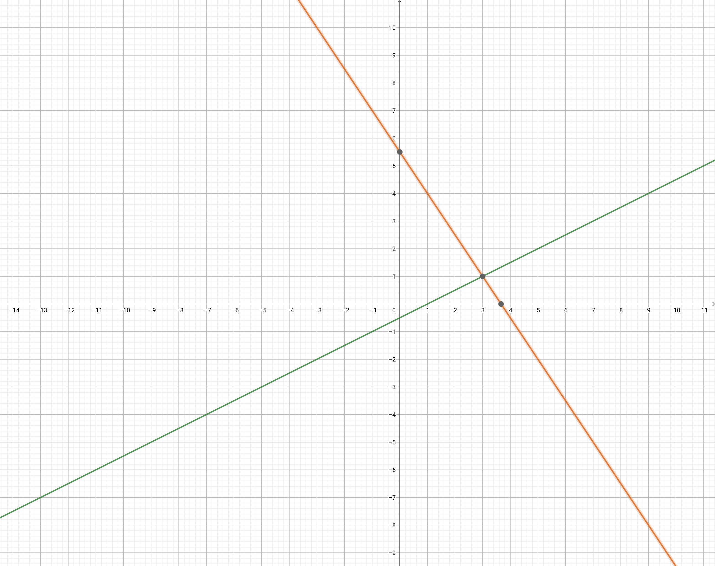

Slide 8
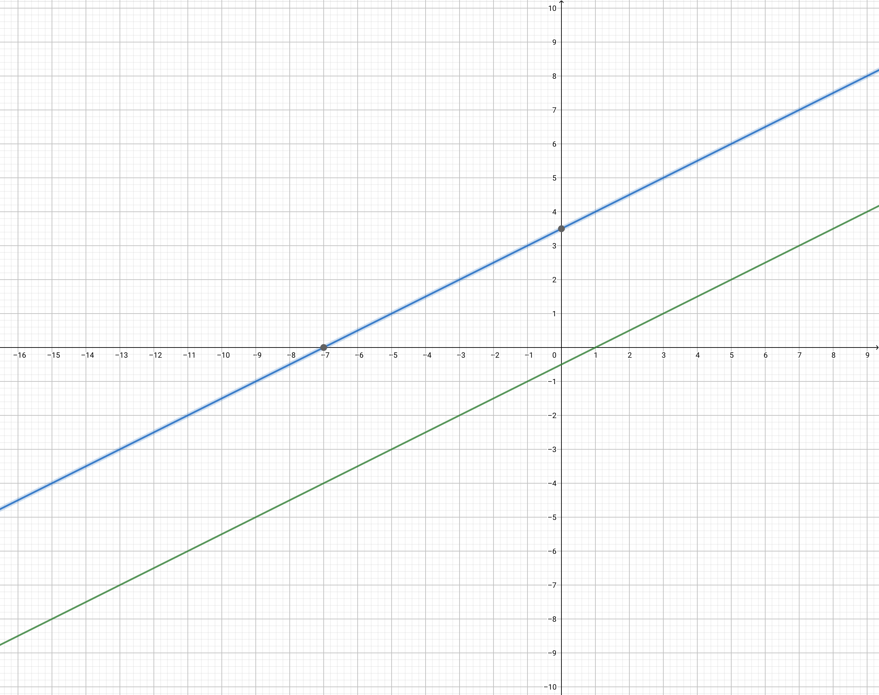

Slide 9
Gauss elimination
Elementary row operation（初等行变换）
(Replacement) Replace a row by the sum of itself and a multiple of another row
(Interchange) Interchange two rows
(Scaling) Multiply all entries in a row by a nonzero constant

Slide 10
Matrix operation for replacement

Slide 11
Matrix operation for interchange

Slide 12
Matrix operation for scaling

Slide 13
Ideal form of a linear system—diagonal form（对角型）

Slide 14
Ideal form of a linear system—upper triangular form（上三角型）

Slide 15
Solve by back substitution（回代）

Slide 16
Example

Slide 17
Ideal form of a linear system—echelon forms（阶梯型）

Slide 19
Example

Slide 20
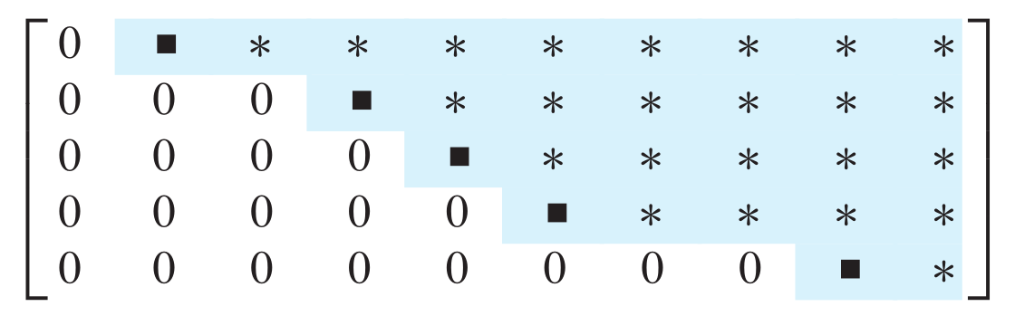
More general echelon form

Slide 21
Example

Slide 22
Can we always reduce a linear system to echelon form?
Yes, by the row reduction algorithm.
Step 1: Find the left most nonzero column, this is called a pivot column（主列）.

Slide 23
Step 2: Select a nonzero entry in the pivot column as a pivot （主元）, If necessary, interchange rows to move it to the first line.

Slide 24
Step 3: Use row replacement operations to creat zeros in all positions below the pivot.
Repeat step 1–3 to the submatrix under the first line and right to the pivot column.

Slide 25
The process terminates in finitely many steps, as there are only finitely many rows.
The process terminates also if there appears a row (0 0 0 b) with b nonzero, as the linear system will have no solution.

Slide 26
Homework
Book of Lay-Lay-McDonald
Exercise 1.1, question 11, 13, 17, 18, 27, 28,
Exercise 1.2, question 2

Slide 27
Next time
Book of Lay-Lay-McDonald, Chapter 1, 1.3-1.4

